Slide 1


AI Companies Around the World
Presented by: Amir Ghalib
Updated: August 24, 2023

Slide 2
Table of Contents
Project Objective & Variables
Data Findings
Conclusion & Recommendations

Slide 3
Objective
Determine the most ideal setup for starting a company that offers AI services in terms of location, minimum costs for projects, average hourly rate for employees, total number of employees and percentage of focus on AI vs non-AI technologies.

Slide 4
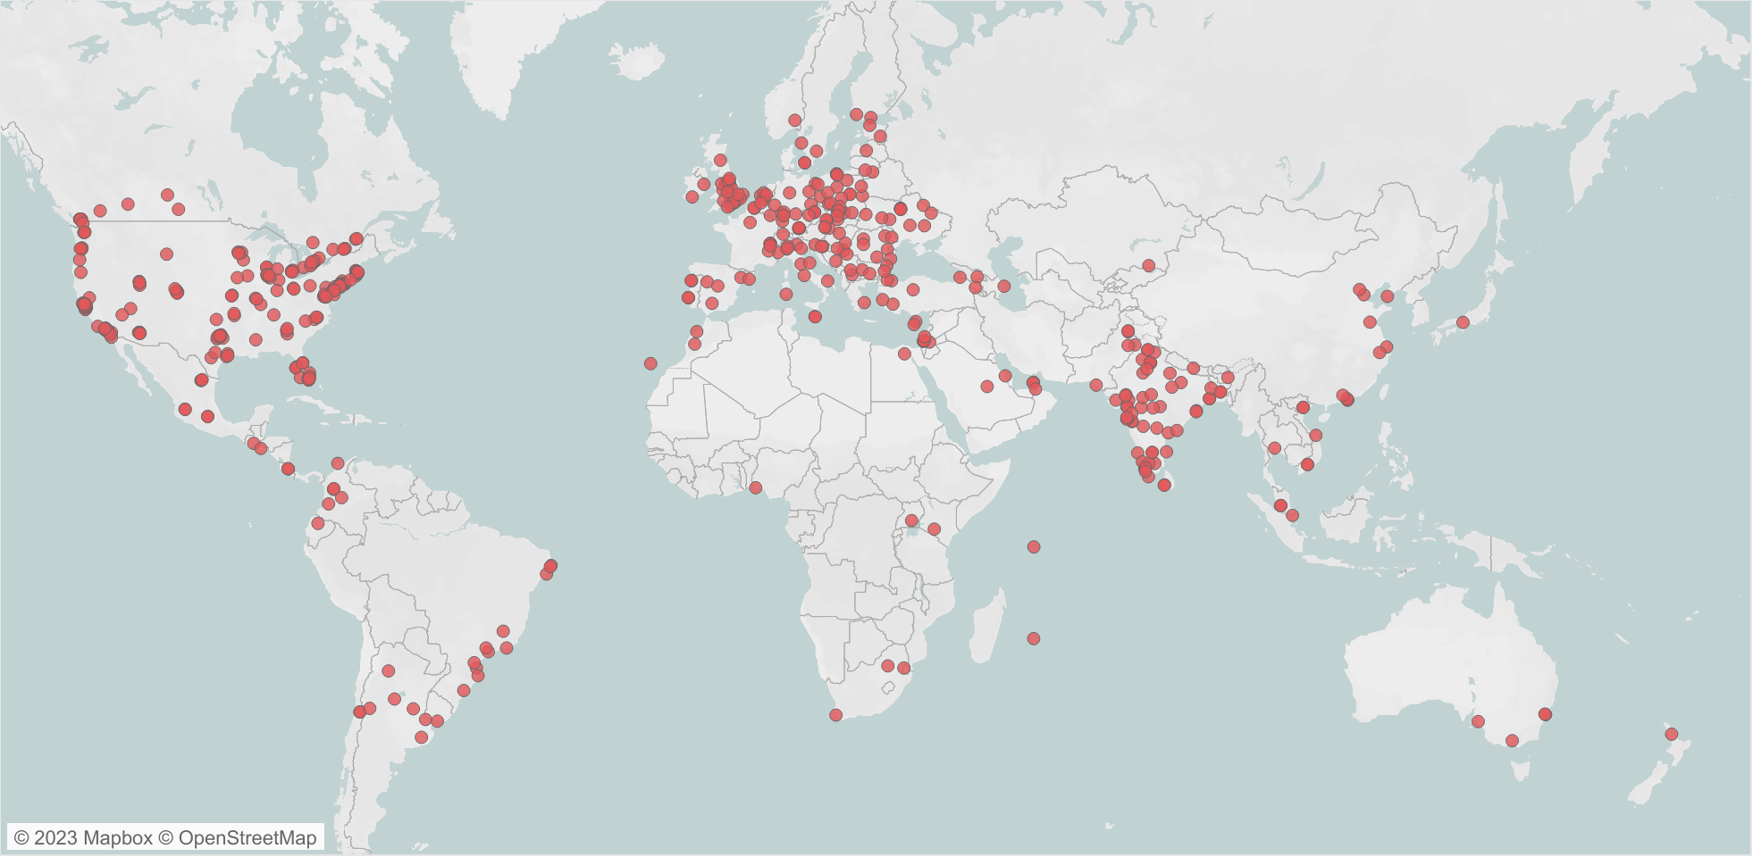
Notes:
—We see that there is a higher concentration of companies in Europe, The United States (in particular, the Eastside), and India
—There are a total of 1,786 companies from the dataset with 645 total locations

Slide 5
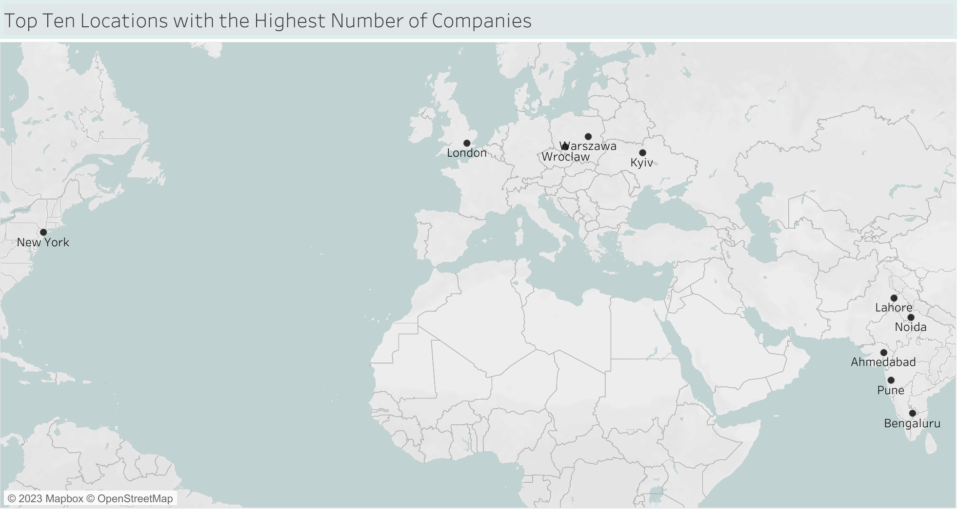
Notes:
—The top ten cities that have the highest number of companies
—London is number one with: 61 companies
--Ahmedabad is number two with: 53
--New York and Warszawa are tied in third with 41

Slide 6
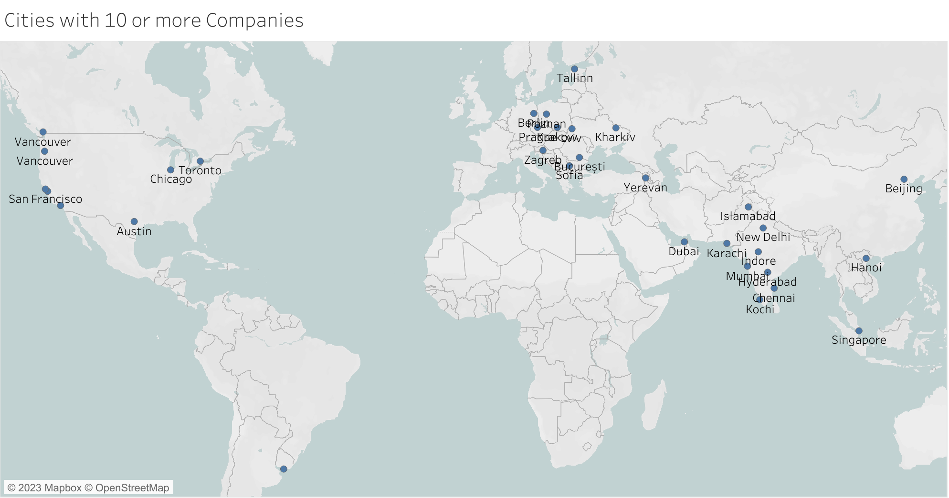
Notes:
—42 locations have 10 or more companies (including the top ten)
—600 locations have less than 10 companies
—There are 425 locations that have only one company
Notes:
--Number of Companies could be influenced by the size of the city (the bigger the city, the higher the number of companies it contains).
--Dataset does not take into account a company's online presence and therefore cannot accurately be relied upon to determine a company’s sphere of influence.
--Dataset does not take into account a company’s multiple branches. Only one branch/location is given for each company.

Slide 7
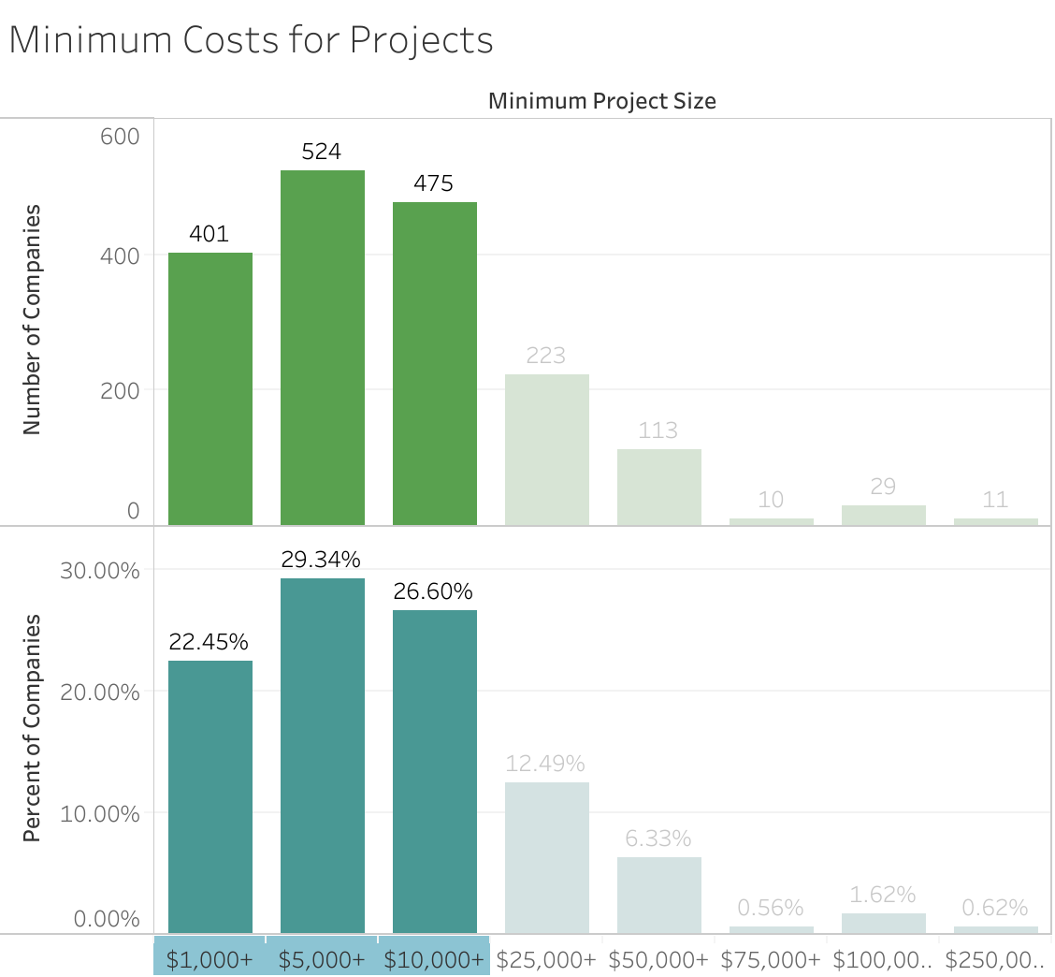
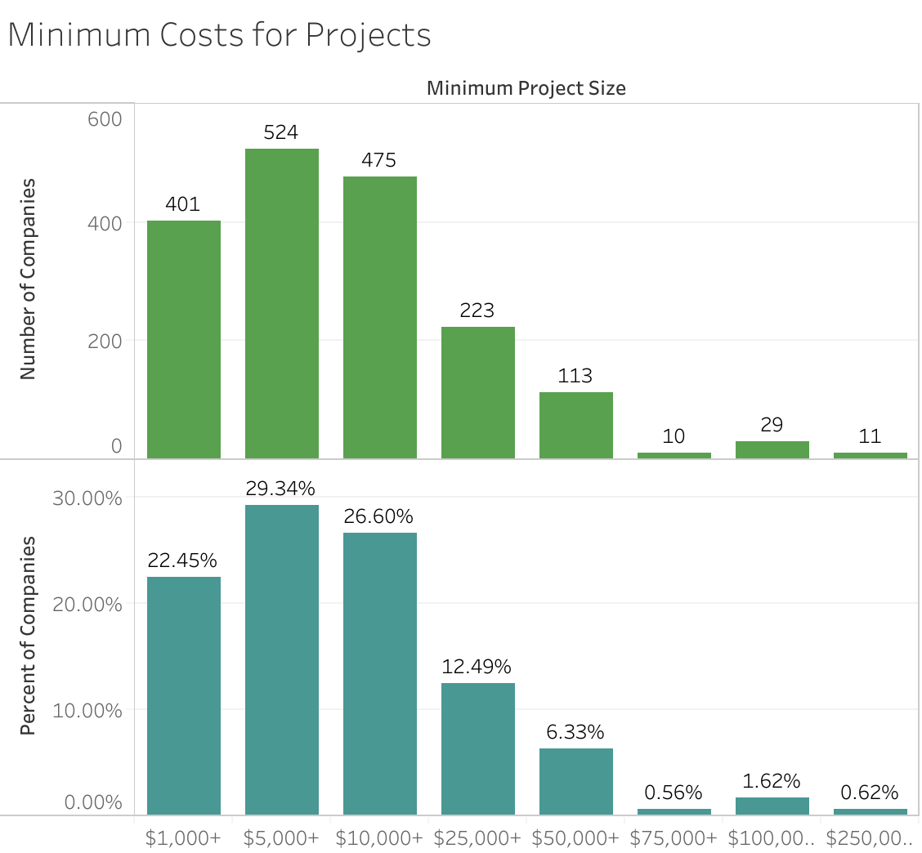
Minimum Cost of Projects
The most common min project sizes are $5,000, $10,000, $1,000 in that order
Notes:
--This is the minimum level cost for a project that I company will engage in
Notes:
—Represents the minimum, not average
—Doesn’t accurately portray the financial capabilities of a company as very large companies might be willing to engage in multiple small projects
—Most companies do not have 100% focus for AI so non-AI focused projects can skew the Minimum Project Cost one way or the other (Same goes for Average Hourly Rate)

Slide 8
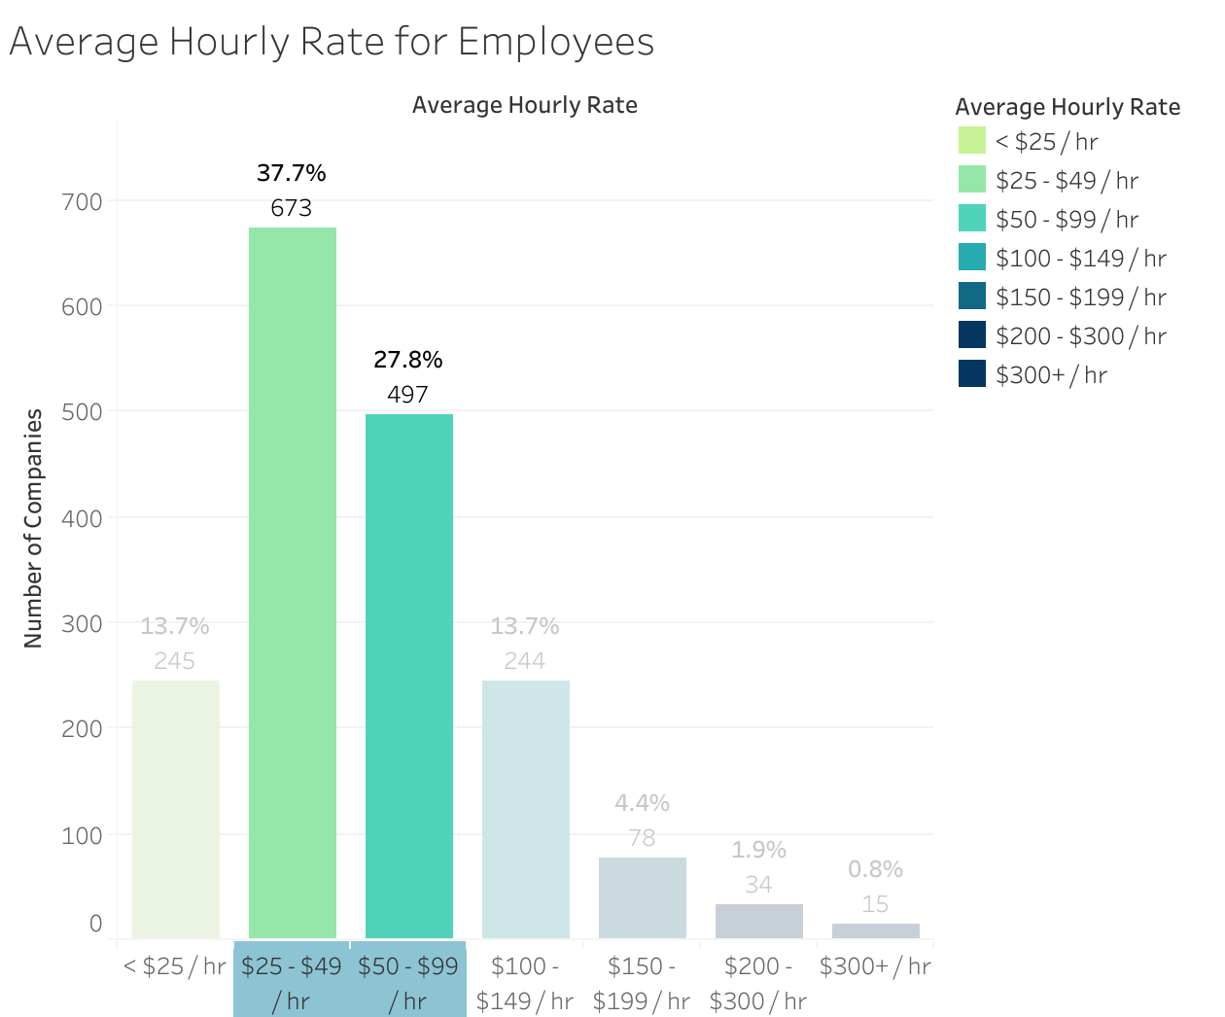
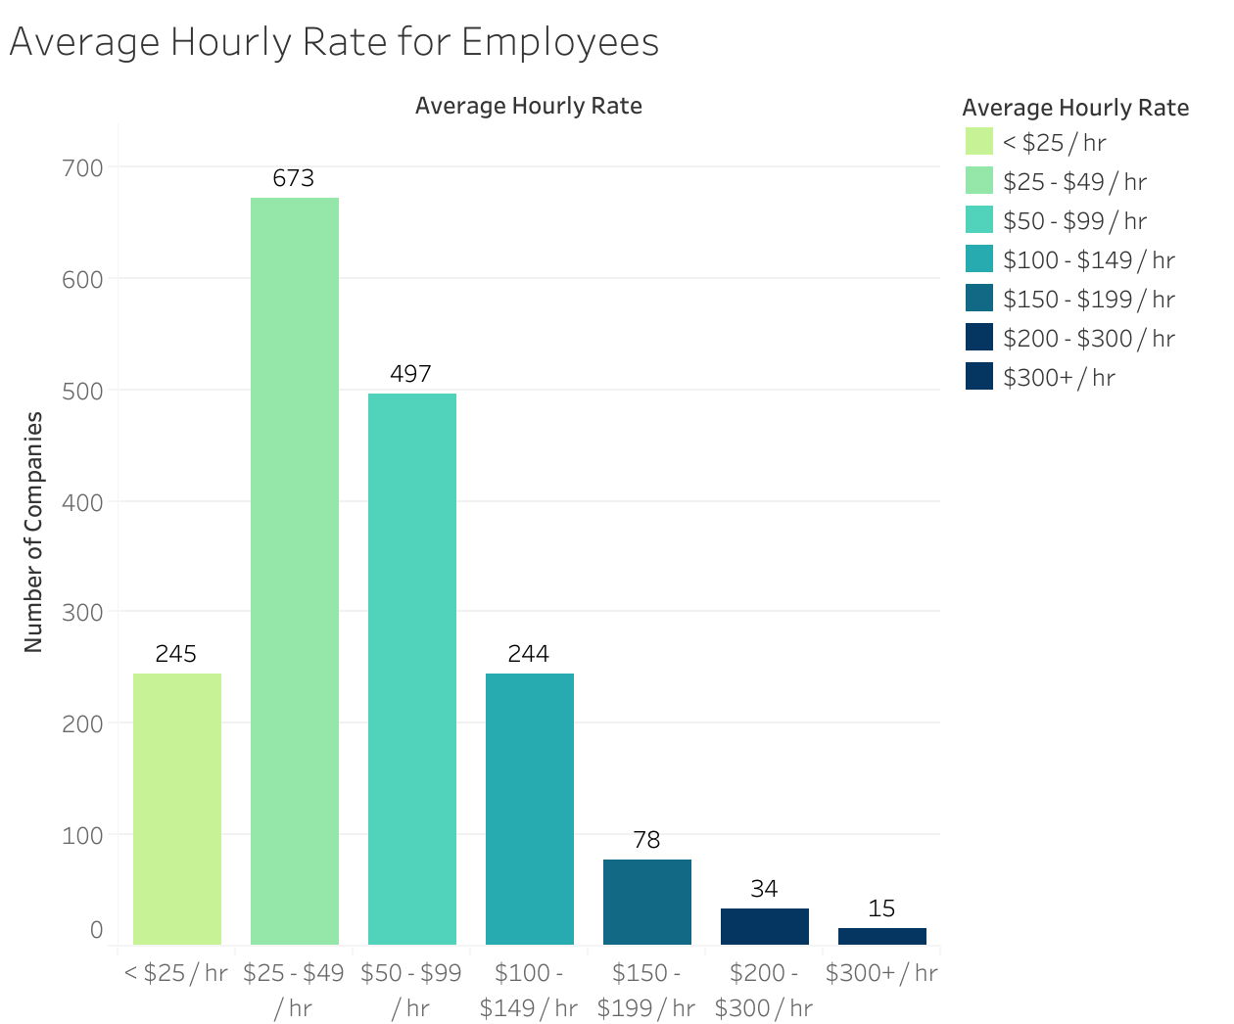
Average Hourly Rate
The most common rate is $25 - $49 / hr
Notes:
--This is the average hourly rate that a company pays its employees
Notes:
—Hourly rates can carry different weights in different countries or even cities within the same country. A low salary in one location could be
—Most companies do not have 100% focus for AI so non-AI focused projects can definitely skew the Average Hourly Rate one way or the other. (Same goes for Minimum Project Cost)

Slide 9
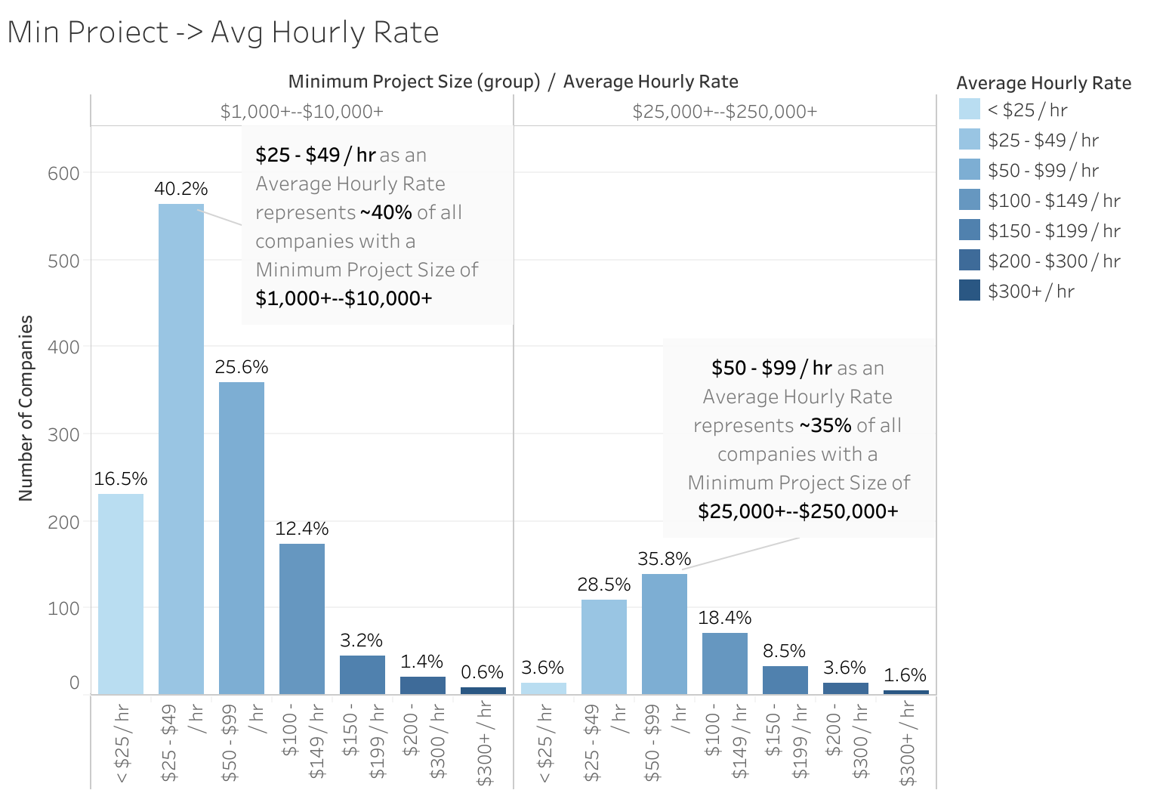
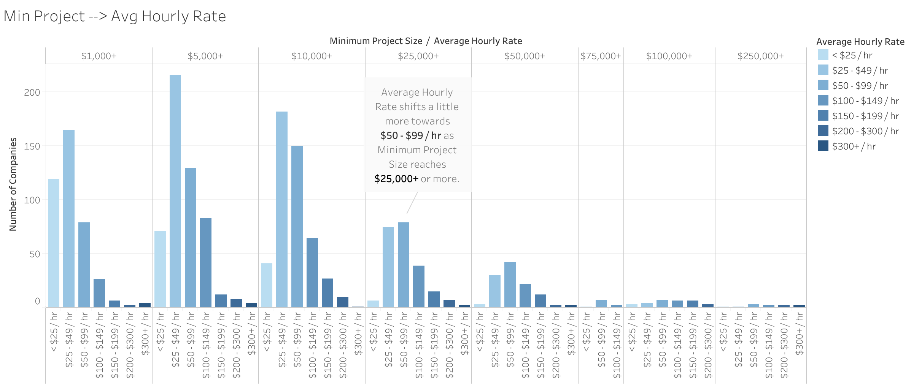
Minimum Project Cost/Average Hourly Rate
Notes:
—We see that the trend shifts more over to the $50 - $99 / hr rate once the Minimum Project Size reaches the $25,000 mark.

Slide 10
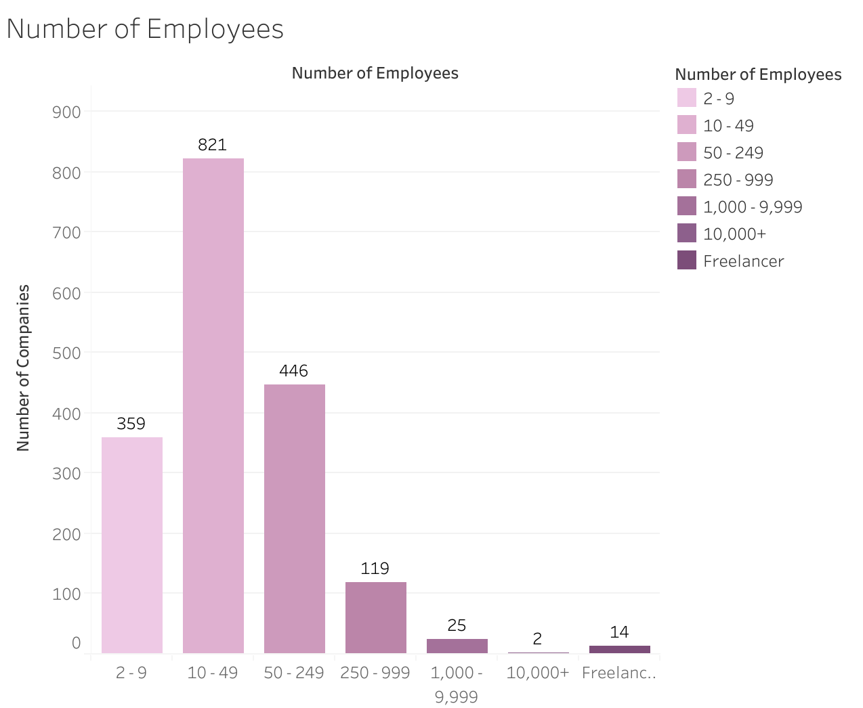
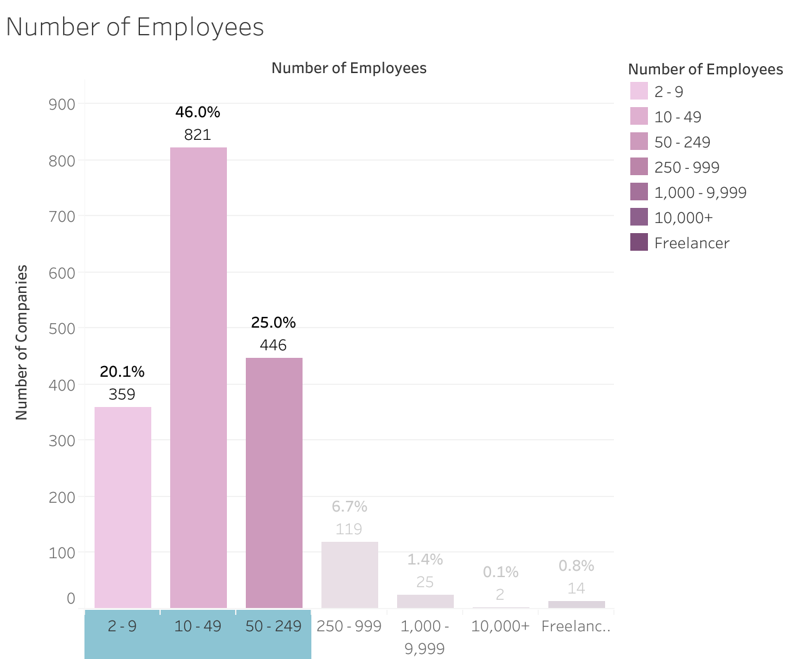
Number of Employees
The most common number of employees is 10-49 representing almost half of all companies
Notes:
--This graph represents the number of employees of each company
—The most common number of employees that each company has is 10-49 representing almost half of all companies

Slide 11
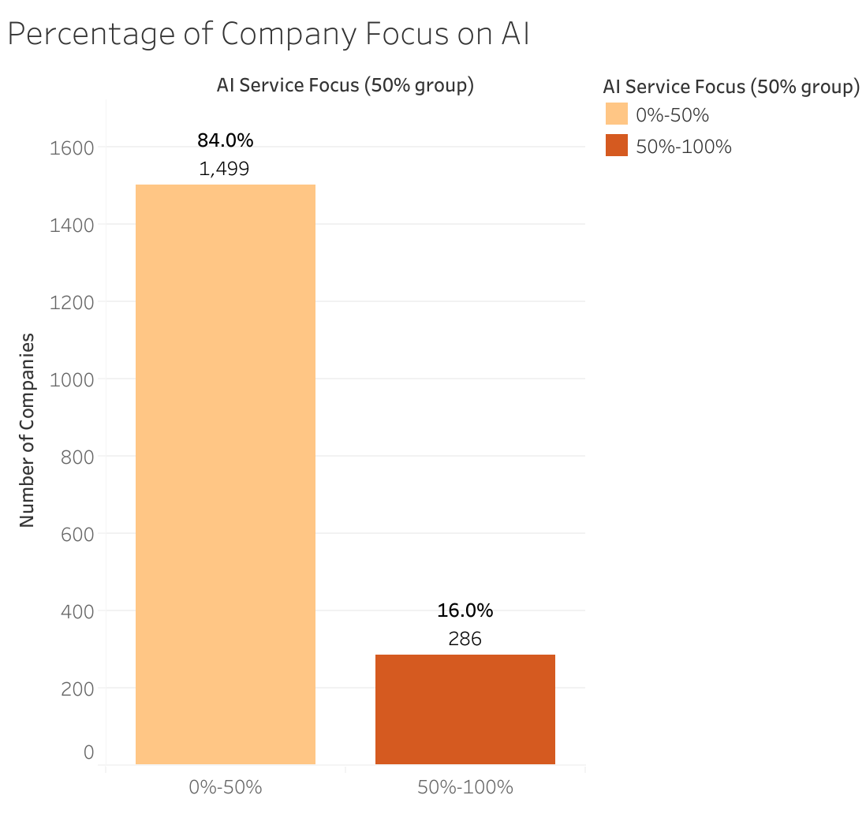
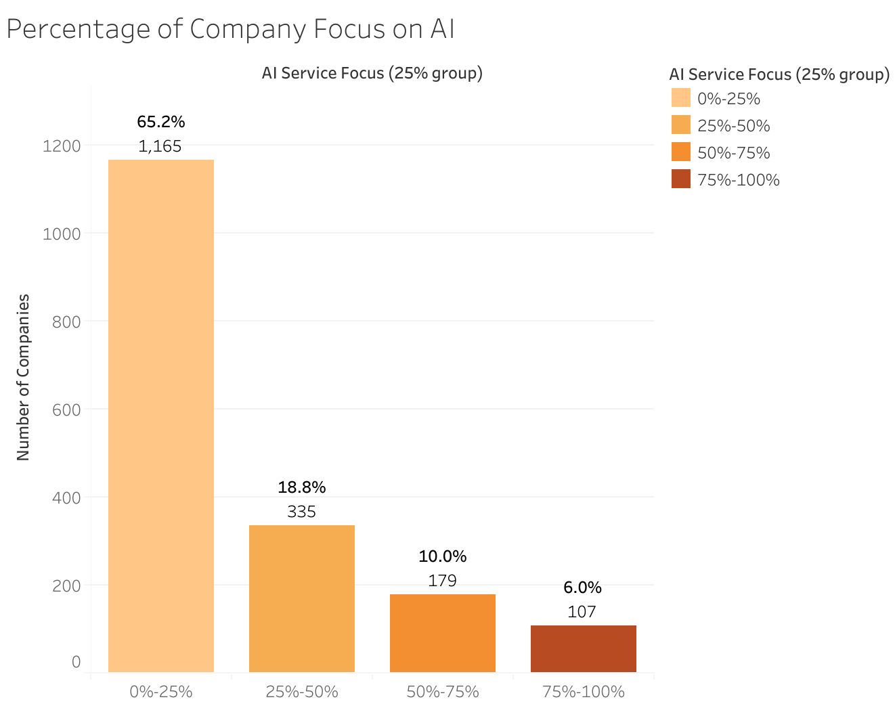
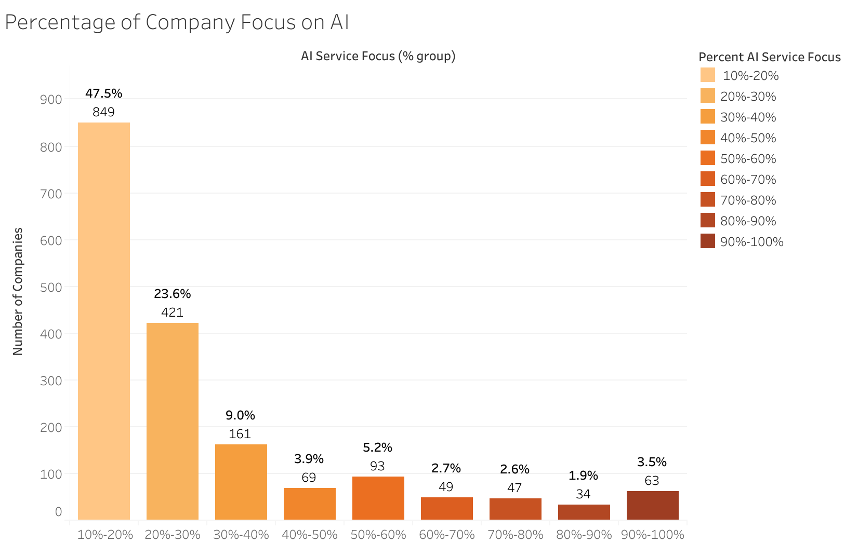
Notes:
—Almost half of all companies dedicate only 10-20% focus to AI (47.43%)
—Very few dedicate at or near 100% to AI (3.5%)
—Dedicating 25% or more of a company’s focus to AI would put one higher than 65% of all companies.
—Dedicating 50% or more of a company’s focus to AI would put one higher than ~84% of all companies in the given dataset
Notes:
—Percentage does not accurately indicate how much actual resources a company is investing in AI. 10% of a large company (for example) could be a lot more resources than 75% or even 100% of a very small company’s resources.

Slide 12
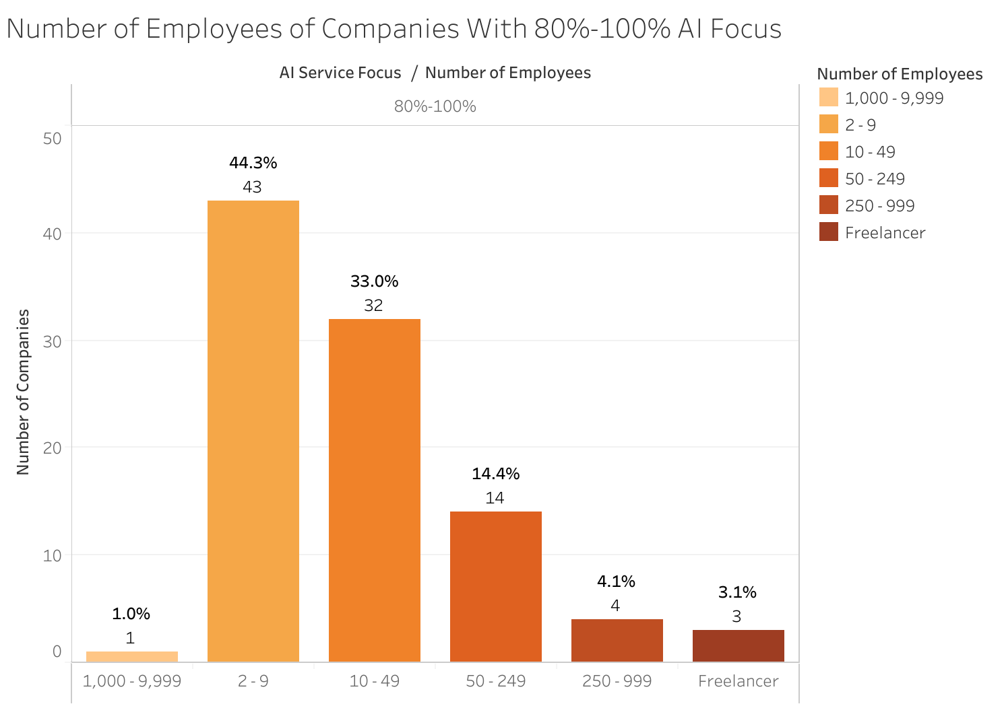
Notes:
— ~44% of companies who dedicated 80-100% of their focus to AI had 2-9 employees

Slide 13
Conclusions and Recommendations
Location
Unclear competition strength in specific regions due to limited data. Further analysis required. Focus on areas with moderate number of companies for potential opportunities.
Minimum Cost of Projects
Based on available data, anticipate a $5,000 minimum per project for competitive market entry. Data may not fully reflect competition due to potential participation of larger companies in smaller projects.
Average Hourly Rate
Global analysis suggests for minimum project size under $25,000, a rate of $25 - $49 / hr is advisable for employee compensation. Above $25,000, $50 - $99 / hr would be more encouraged with $25 - $49 / hr still being a good option. Local Average Hourly Rate variations require further analysis.
Number of Employees
Recommended staffing: 10-49 employees. If AI focus exceeds 80%, consider 2-9 employees, yet 10-49 remains a viable option.
Percent of Focus
Full dedication to AI isn't required for market participation. A 25% focus surpasses 65% of other firms. At 50% or more, you're more focused than 84% of companies. Note: Focus doesn't equate to AI resources, as smaller percent of larger company could be substantial. More data required.
Notes:
--Q&A

